Slide 1
S3: Hate Speech Detection and Errudite
Robert Halwaß, Adelia Gaifutdinova, Ammon Stretz

Slide 2
Agenda
Quick recap & goals
Technical Solution
Methodology
Error Classes
Three best Error Classes
Additional Error Classes
Conclusion

Slide 3
Quick recap:
Hate Speech detection
Collaboration with FU: Dehumanization, Threat of Violence, Generalization
Overall goal:
To reach better F1 score for the Hate Speech detection using BERT-Model by identifying and trying different Error Classes (current F1: 0.59)
Check usability of Errudite for Hate Speech Domain

Slide 4
Our Goals for S3:
Define 10 Error Classes
Visualize and analyse each Error Class
Extract the best Error Classes
Based on the impact to F1 score

Slide 5
Errudite
Contains Quantitative Analysis
Domain-Specific Language for extracting relevant features of linguistic data
Visualizes features and Error Classes
Preprocessing of test data
GUI is only usable for QA and VQA (confirmed by developer)
Errudite Jupyter solution only offers limited functionality
DSL
Data management
Visualisation

Slide 6
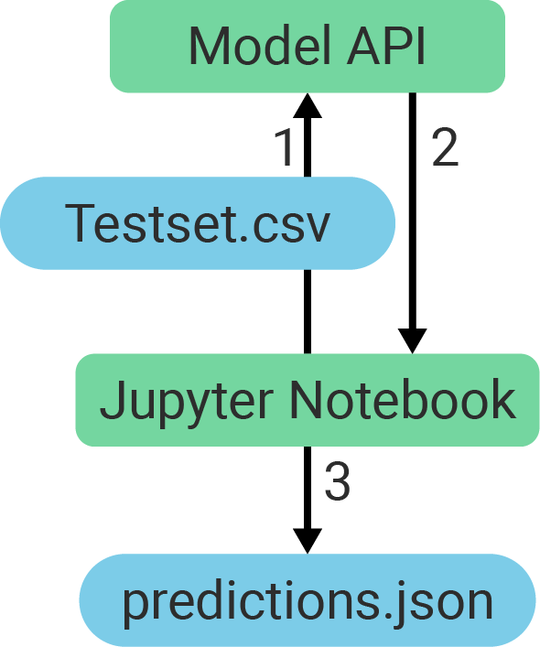
Workflow
Initial step:
Send Testset to model (670 comments)
API returns predictions
Save predictions as .json file

Slide 7
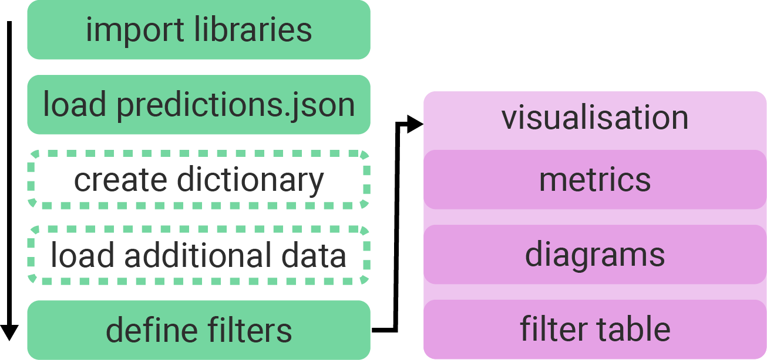
Workflow
Create Error Class:
Import of other data via CSV file
Creation of confusion matrix and diagrams

Slide 8
Methodology
Manual analysis
Analysis based on “Machine Learning Yearning” by Andrew Ng (2018)
Hypothesis
Select 100 random samples
Categorize error sources
Repeat 3 times
Also using error classes described in scientific papers

Slide 9
Error Classes

Slide 10
#1: Rhetorical Questions
Hypothesis: Toxic statements are often hidden within rhetorical questions
Reason: “It is common practice to wrap toxic statements online within rhetorical or suggestive questions as pointed out by Schmidt and Wiegand (2017).” (Challenges for Toxic Comment Classification: An In-Depth Error Analysis”, van Aken et al. 2018)

Slide 11
#1: Rhetorical Questions
Example:
ID | Label | Prediction | Confidence | Comment
4 | 0 | 1 | 0.94 | Also muss ich aufgrund der Angst anders anziehen und auf jegliche Religionsfreiheit uä verzichten wegen dem Faschismus im Osten?
38 | 0 | 1 | 0.97 | Was macht die Frau in Deutschland? Sich vor der Wehrpflicht zu drücken, begründet kein Asyl. Und Migranten kennt unser Asylrecht nicht. Also, was macht die Frau hier?
205 | 0 | 1 | 0.51 | Wenn der \"Leibwächter von Bin Laden\" kein waschechter Terrorist ist, was war dann Bin Laden selbst?

Slide 12
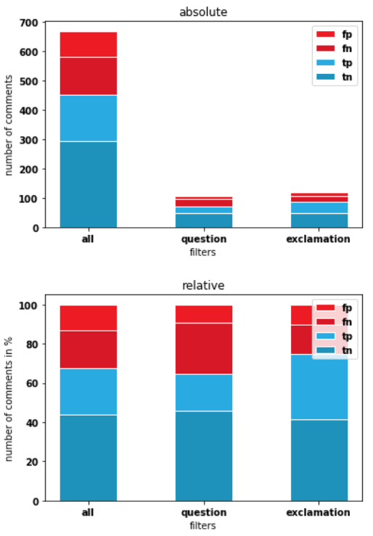
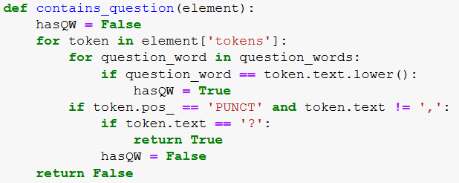
#1: Rhetorical Questions
Implementation: - Search sentences for question words and question mark
Filter:

Slide 13
#1: Rhetorical Questions
Metrics:
Conclusion: Adding more training data containing comments with rhetorical questions, could benefit the model
 | Precision | Recall | Accuracy | F1 | TP/TN/FP/FN
Error Class | 0.66 | 0.42 | 0.64 | 0.51 | 20/49/10/28
Model Before | 0.64 | 0.55 | 0.67 | 0.59 | 157/295/88/130
Model After | 0.70 | 0.64 | 0.73 | 0.67 | 185/305/78/102

Slide 14
#2: Uppercase Words and Acronyms
Hypothesis:
The model overemphasizes words written in upper case, especially acronyms.
Reason:
Manual Analysis

Slide 15
#2: Uppercase Words
Example:
ID | Label | Prediction | Confidence | Comment
159 | 0 | 1 | 0.91 | Das bedeutet aber nicht, dass diese Menschen auch der BILD folgen oder das glauben, was in dem Schundblatt steht. Auch ich schaue mir die Artikel gelegentlich an – es ist wichtig, zu wissen, was der Feind so von sich gibt. Und ich gehe davon aus, dass sämtliche Politiker in Deutschland regelmäßig die eigene Propaganda lesen wollen.
547 | 0 | 1 | 0.66 | Merkel betreibt eine Grüne Politik. Sie ist eine Grüne Kanzlerin. Und die CDU Basis lässt sich das bieten...
659 | 0 | 1 | 0.74 | Merkel hat mit der Grenzöffnung Europa den größten Schaden seit dem 2. WK zugefügt!

Slide 16
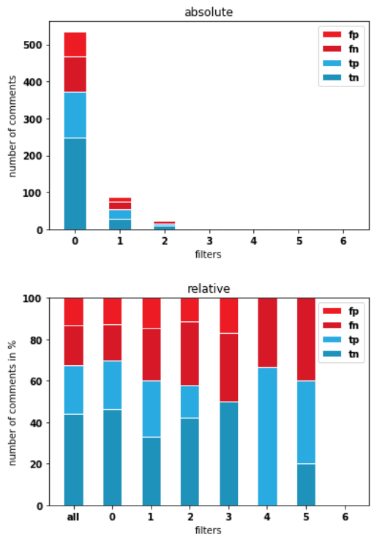
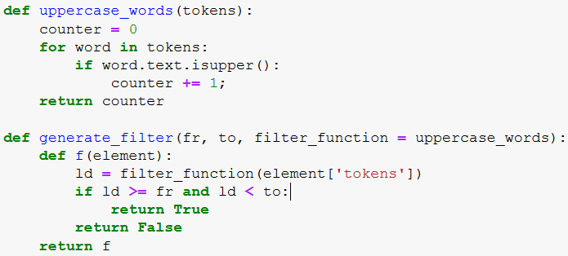
#2: Uppercase Words
Implementation: - Contains at least one token written completely in uppercase
Code:

Slide 17
#2: Uppercase Words
Metrics:
Conclusion: Adding more training data containing comments with multiple words written in uppercase, could benefit the model
 | Precision | Recall | Accuracy | F1 | TP/TN/FP/FN
Error Class | 0.62 | 0.48 | 0.59 | 0.54 | 32/47/20/35
Model Before | 0.64 | 0.55 | 0.67 | 0.59 | 157/295/88/130
Model After | 0.74 | 0.67 | 0.76 | 0.70 | 192/315/68/95

Slide 18
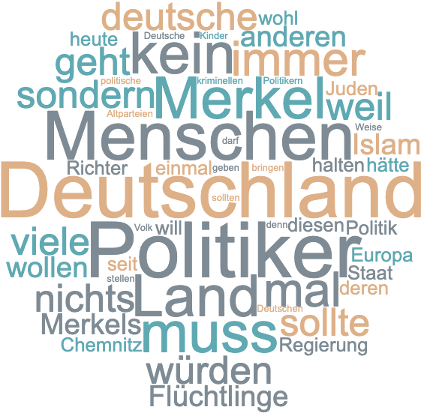
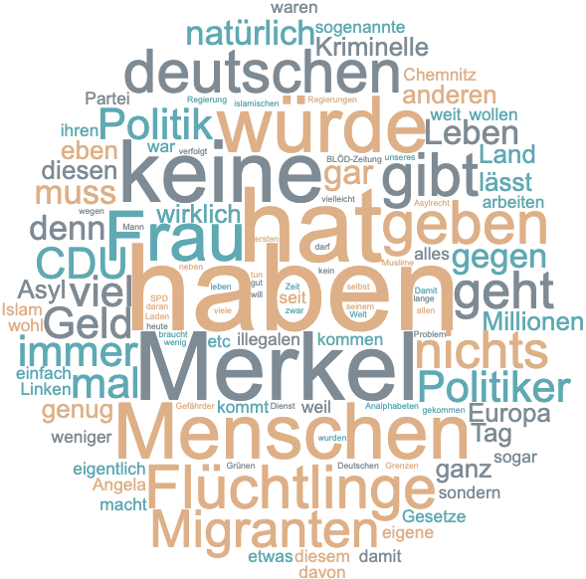
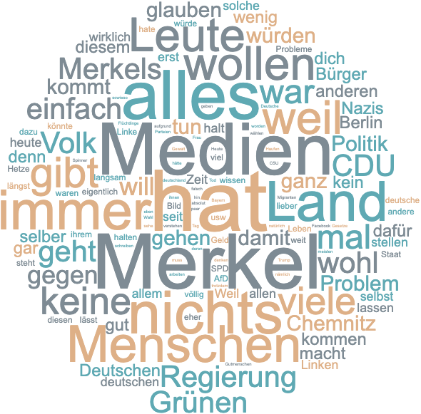
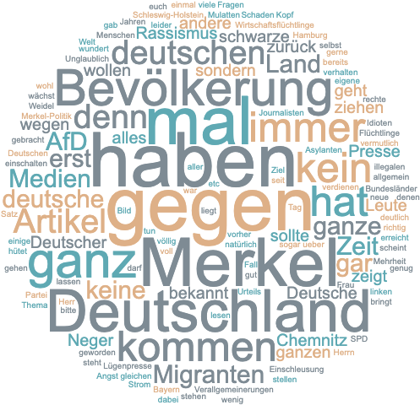
Wordcloud
True-Positive
False-Positive
False-Negative
True-Negative

Slide 19
#3: Occurrences of Nationalities
Hypothesis:
The model reacts too sensitive to mentionings of nationalities, since it could be a generalization based on ethnicity
Reason:
Manual Analysis

Slide 20
Error Class #3: Occurrences of Nationalities
Example:
ID | Label | Prediction | Confidence | Comment
38 | 1 | 0 | 0.73 | Manche Gäste kennen nicht die anderen kulturellen Regeln, manche setzen sich rüpelhaft darüber hinweg, wie am Strand oft einige Briten und Russen
106 | 1 | 0 | 0.83 | Ist doch so oder so nur wieder eine Beruhigungspille, für das gutgläubige deutsche Volk
315 | 1 | 0 | 0.51 | Der Bürgermeister von Boostedt hat mutig und eindrucksvoll beschrieben, wie furchtbar sich die afrikanischen Migranten, die keine Bleibeperspektive haben, verhalten und wie die Akzeptanz in der Bevölkerung schwindet

Slide 21
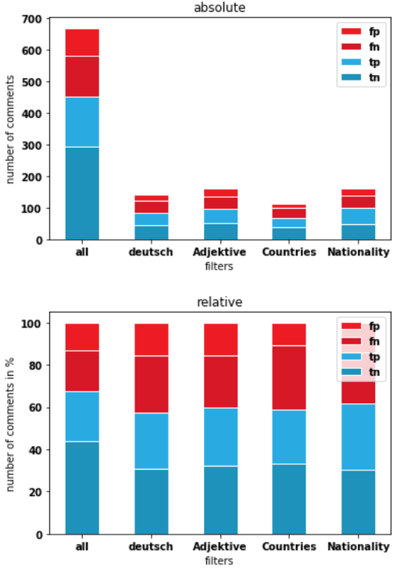
#3: Occurrences of Nationalities
Implementation: - Contains lowercase substring based on list of nationalities (about 199 * 4 words)
Filter:

Slide 22
#3: Occurrences of Nationalities
Metrics:
Conclusion: Adding more training data containing comments with references to nationailites, could benefit the model
 | Precision | Recall | Accuracy | F1 | TP/TN/FP/FN
Error Class | 0.69 | 0.57 | 0.62 | 0.62 | 51/49/23/39
Model Before | 0.64 | 0.55 | 0.67 | 0.59 | 157/295/88/130
Model After | 0.75 | 0.68 | 0.77 | 0.72 | 196/318/65/91

Slide 23
Additional Error Classes
Textlength
Hypothesis: “The meaning of a comment with less than 5 words are harder to understand, compared to longer comments”
Example: “völlig Weltfremd sind die Verantwortlichen” (false-positive)
Metrics: F1: 0.67(0.00), TP: 1 TN: 2 FP: 1 FN: 0
Negation
Hypothesis: “The use of negations can make it harder to understand the meaning of comment for the model”
Example: “Alle anderen waren und sind keine Flüchtlinge, denn sie wurden weder verfolgt noch kommen sie aus Kriegsgebieten. <...>” (false-positive)
Metrics: F1: 0.59(0.00), TP: 84 TN: 135 FP: 40 FN: 76

Slide 24
Additional Error Classes
Animals as Insults
Hypothesis: “The model has problems recognizing if an animal references is meant dehumanizing”
Example: “CH HABE MIT GENÜGEND DIESER AFFEN GESPROCHEN UND BITTERE ERFAHRUNGEN GEMACHT <...>” (false-negative)
Metrics: F1: 0.67(0.02), TP: 11 TN: 8 FP: 3 FN: 8
Readability
Hypothesis: “The meaning of comments with an “Automated Readability Index” higher than 8 are harder to understand for the model”
Example: “Herzlich Willkommen asozialer Abschaum und primitiver Bodensatz der moslemischen Dritten Welt!” (Index: 19.6; false-positive)
Metrics: F1: 0.57(0.02), TP: 105 TN: 183 FP: 60 FN: 95

Slide 25
Additional Error Classes
Misspelled Words
Hypothesis: “The meaning of comments containing multiple misspelled words are harder to understand”
Example: “Schon viele Artikel ueber fluechtlinge gelesen und so manches mal wusste ich nicht ob ich lachen oder weinen sollte abe r dieser Artikel uebertrifft alles <...>” (false-negative)
Metrics: F1: 0.61(0.11), TP: 44 TN: 48 FP: 16 FN: 40
Multi-Word-Phrases
Hypothesis: “Using multiple words together can drastically change the meaning of the individual words, which makes it harder to understand the overall meaning”
Example: “Das CDU-SPD-Regime in Dresden verschwindet wie ein Furz im Wind.” (false-negative)
Metrics: F1: 0.49(0.08), TP: 20 TN: 48 FP: 18 FN: 23

Slide 26
Additional Error Classes
Separately Standing Profanity
Hypothesis: “Because the profane word is separated from the rest of the sentence, the model has problems to infer if it is an insult or an alone standing profane word.”
Example: “Ja ja der Osten, sind schon sehr von sich überzeugt ,die analritter.” (false-negative)
Metrics: F1: 0.61(0.02), TP: 6 TN: 12 FP: 1 FN: 6

Slide 27
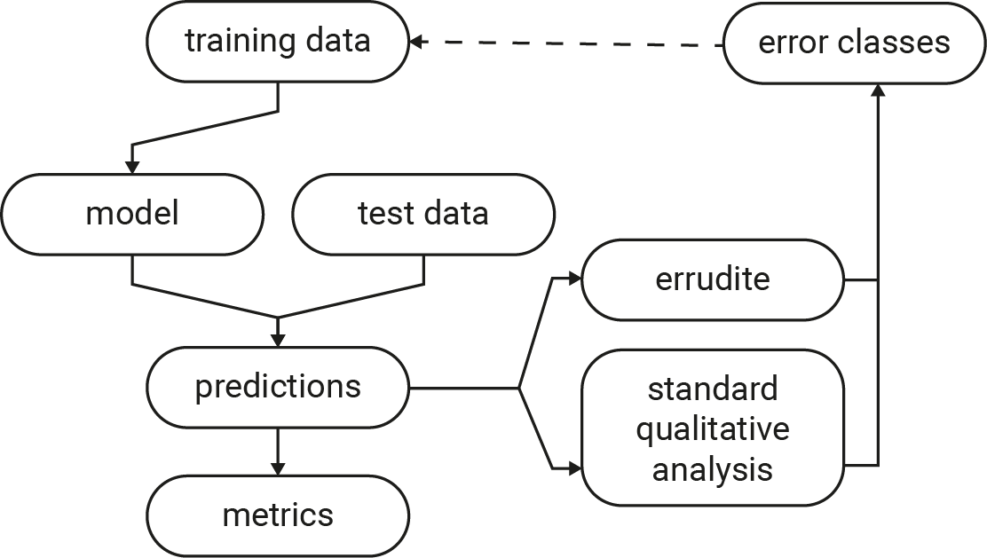
Overall Conclusion
Errudite too specialized for QA and VQA
Identified 3 best error classes which delivered significant results
F1 score improved in range of 8% and 13%
Can also be applied to improve other model’s predictions probabilities
Further ways of improving metrics:
Change / add input data (e.g. with preprocessing)
Change type of model (e.g. fasttext => cnn)
Change usage of model (e.g. number of epochs)

Slide 28
Evaluation
 | Error Class Name | Grade (1: easier, 6: harder)
1. | Uppercase Words and Acronyms | 1
2. | Occurrences of Nationalities | 1
3. | Separately Standing Profanity | 2
4. | Negation | 3
5. | Textlength | 3
6. | Multiword Phrases | 3
7. | Rhetorical Questions | 4
8. | Animals as Insults | 4
9. | Misspelled Words | 5
10. | Readability | 6

Slide 29
Thank you for your attention!

Slide 30
*Addinitional Error Classes Reasons
Animal as Insult Reason: Manual Analysis
Readability Reason: "There are actually many cases where abusive language, or even more specifically hate speech, is quite fluent and grammatical." (Abusive Language Detection in Online User Content, Nobata et al. 2016)
Negation Reason: “Negation is often found in false positives such as ‘I honestly hate the term ‘feminazi’ so much. Stop it’. Further, expression of Stereotypical views such as in ‘... these same girls ... didn’t cook that well and aren’t very nice’ is also common in false negative sexism tweets. These are difficult to capture because they require understanding of the implications of the language.” (Detecting Hate Speech on Twitter Using a Convolution-GRU Based Deep Neural Network, Zhang et al. 2018)
Text Length Reason: “We can see that our model is confused in understanding the meaning of short sentences of less than five words. It is hard for our model to understand the context of short sentences, since these are few words that does not contain abusive words.“ (Detecting context abusiveness using hierarchical deep learning, Lee et al. 2019)

Slide 31
*Addinitional Error Classes Reasons
Misspelled Words Reason: “Because online comments often do not basically follow formal language conventions, there are many unstructured, informal and often misspelled and abbreviations. These make the abusive detection very difficult.“ (Detecting context abusiveness using hierarchical deep learning, Lee et al. 2019)
Multiword Phrases Reason: “We see many occurrences of multi-word phrases in both datasets. Our algorithms can detect their toxicity only if they can recognize multiple words as a single (typical) hateful phrase.” (Challenges for Toxic Comment Classification: An In-Depth Error Analysis, van Aken et al. 2018)
Separately standing profanity Reason: “The profane word stands separately at the end or right after a sentence” (Detecting Online Harassment in Social Networks, Brettschneider et al. 2019)

